Slide 1
Data readiness assessment, roadmap and 90-day plan (practical)
How ready is my organisation’s data for AI, what will I fix first, and who will own it?
Applied AI and Automation | Session 14 of the 15 (Sessions 0 to 14)
KLAi Professional Learning | Jotham Martin Wambi
Notes:
Welcome to the last session. Last time you wrote rules and vendor questions, and rules need good information underneath them. Over thirteen sessions you have seen how models learn, how language models work, how to prompt and check them, what agents can do, and how to set rules and question vendors.
Today the question turns to your own organisation. How ready is my organisation’s data for AI, what will I fix first, and who will own it? You leave with a plan, three dates and the follow-up kit.

Slide 2



What you will leave with today
By the end of today you will have
A data inventory and a readiness scorecard for your own organisation, scored out of 12
A data roadmap and a 90-day plan: actions with owners, milestones, hours and a KPI someone else can check
The follow-up kit, and one picture of all fourteen sessions that you can explain to a colleague
Notes:
That question gives you three things to hold. An inventory of your information and a readiness scorecard scored out of twelve. A roadmap and a ninety day plan, where every action has an owner, a date, the hours and a measure that someone else can check. The follow-up kit for the check-ins.
And one picture of all fourteen sessions, which you can explain to a colleague in a minute. Nobody scores you. The plan is the result.

Slide 3
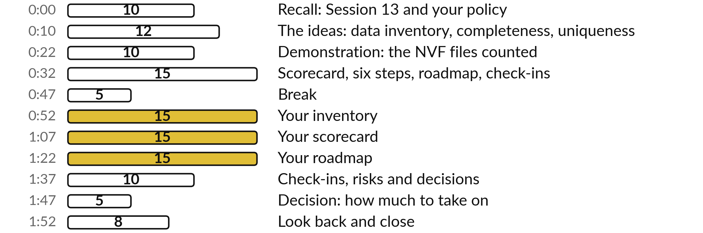
In the last two hours, fifty-five
minutes build your own plan
55 of the 120 minutes are yours: inventory, scorecard, roadmap, check-ins.
Notes:
To build all of that, we need to plan the two hours. This is the last session, so it builds the plan you take back to work. After a short recall of Session 13, I build the data inventory, completeness and uniqueness on a tiny contact list, then count what is wrong in the NVF files.
Then we score them on the readiness scorecard, plan the six steps and draw the roadmap with its check-ins. After the break you build your inventory, your scorecard, your roadmap and your check-ins. We finish with one decision and a look back over all fourteen sessions. First, three questions from last time.

Slide 4
Three questions from last time
1. How is a risk scored in the Risk Register, and which scores are High?
2. Name two red flags in the OrbitDesk proposal and the question each one needs.
3. My understanding: which law covers personal data in AI tools in Uganda, and who confirms it for you?
Answer aloud first. Then we check together.
Notes:
Three quick questions from Session 13. Answer aloud first, and then we check together.
Question one. How is a risk scored in the Risk Register, and which scores are High? Take a moment.
A good answer is this. Likelihood from 1 to 5 times impact from 1 to 5. High is 15 or more, Medium is 8 to 14, Low is below 8.
Question two. Name two red flags in the OrbitDesk proposal and the question each one needs. Say it to yourself first.
A good answer is this. Any two of: payments with no approval step, a request for bank login, training on your data by default, 36 months with no exit, no usage cap, no references, a deadline. For each, ask for the control, the proof or the clause in writing.
Question three. My understanding: which law covers personal data in AI tools in Uganda, and who confirms it for you? Think about your own work as you answer.
A good answer is this. The Data Protection and Privacy Act 2019. Your lawyer confirms which duties apply to your uses.
If an answer was missing, last session’s take-away sheet has it.

Slide 5
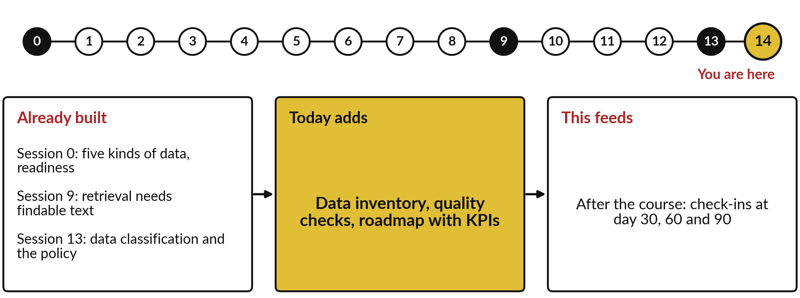
What today builds on, and where it leads
Each session is built on the ones before it.
Notes:
The dots along the top are the fifteen sessions, from the map at Session 0 to your plan at Session 14; the gold one is today.
Today uses five kinds of data, readiness from Session 0, retrieval needs findable text from Session 9 and data classification and the policy from Session 13.
It adds data inventory, quality checks, roadmap with KPIs.
After the course: check-ins at day 30, 60 and 90.

Slide 6
Words we use today
Word | What it means
Data inventory | A written list of the data sources you hold, with owner, location and who may see each.
Data quality dimensions | The standard checks: completeness, accuracy, consistency, timeliness, uniqueness and validity.
Metadata and lineage | Metadata is data about the data, such as date, owner and version. Lineage is the recorded path of data from its source to its use.
Data governance | The policies, roles and rules that decide who may do what with which data.
Roadmap and KPIs | A plan of actions with owners and milestones. A KPI, key performance indicator, is a number that shows progress.
Evaluation set | Questions with known answers, used to measure how well a system performs.
Notes:
6 words for today. We use every one of them before the end of the session.
Data inventory. A written list of the data sources you hold, with owner, location and who may see each.
Data quality dimensions. The standard checks: completeness, accuracy, consistency, timeliness, uniqueness and validity.
Metadata and lineage. Metadata is data about the data, such as date, owner and version. Lineage is the recorded path of data from its source to its use.
Data governance. The policies, roles and rules that decide who may do what with which data.
Roadmap and KPIs. A plan of actions with owners and milestones. A KPI, key performance indicator, is a number that shows progress.
Evaluation set. Questions with known answers, used to measure how well a system performs.

Slide 7
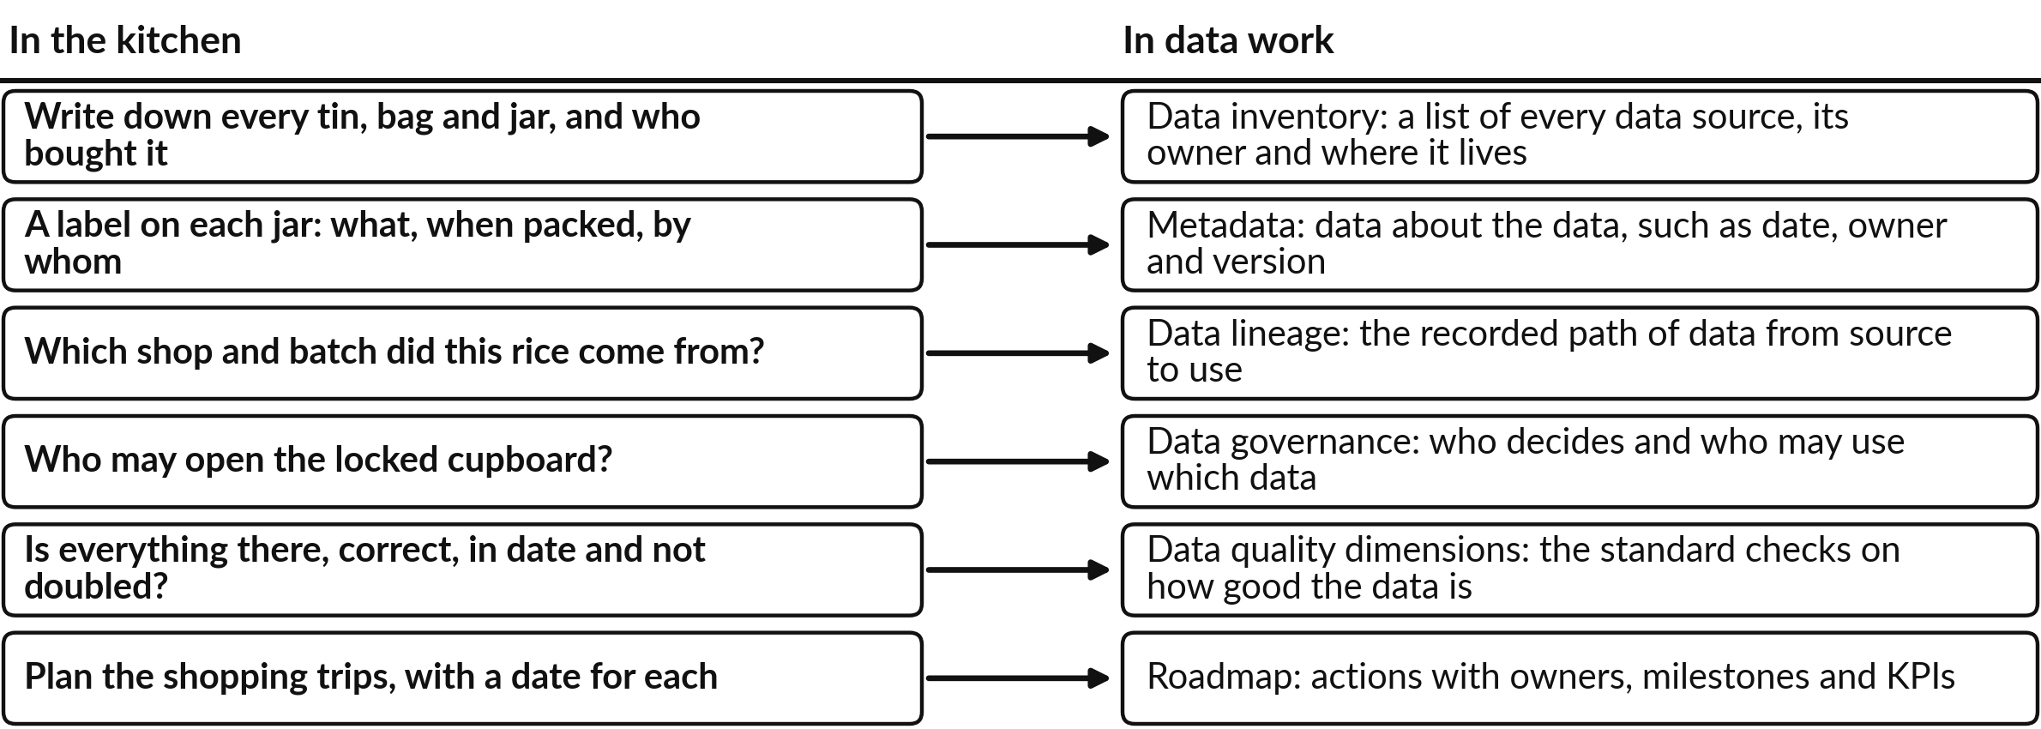
Preparing data for AI is a pantry
audit before you cook a big meal
Left: the pantry. Right: the standard term in data work.
Notes:
Every word of today has a twin in the kitchen, so let us start there. Before you cook a big meal you audit the pantry. You write down what you have, check each label, know where the rice came from, decide who may open the locked cupboard, and check that nothing is missing, wrong, out of date or doubled.
Data work has a standard name for each habit: data inventory, metadata, lineage, data governance and data quality dimensions. Then you plan the shopping, which in data work is a roadmap. The analogy breaks in one place. Food spoils where you can see it, while data can quietly become wrong or out of date without anyone noticing.
Which habit does your organisation skip?

Slide 8
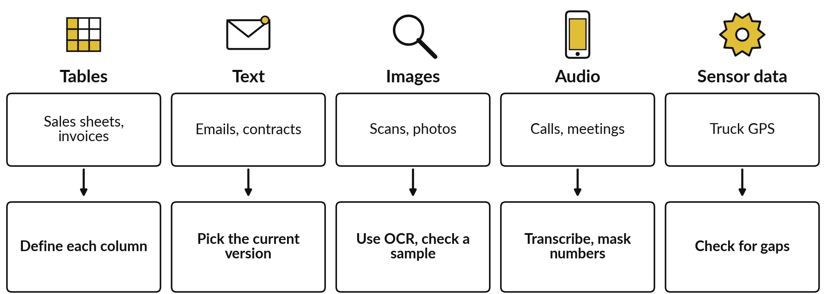
Five kinds of data, five first steps
Tables are structured data. The rest is unstructured.
Notes:
Readiness starts with knowing what you hold. Session 0 showed that companies hold five kinds of data and that most of it is unstructured; today each kind gets its first step. Tables are structured data, with named columns. Text, images and audio are unstructured. Session 1 showed that an image is a grid of numbers, so a scan is only an image until optical character recognition, OCR, reads the text from it, much as you would copy the words off a photo of a receipt.
For each kind there is one first step. Define every column in a table. Find the current version of a text. Read an image with OCR and check a sample. Transcribe audio and remove phone numbers. Check sensor readings for gaps. Which kind does your organisation hold most of?

Slide 9
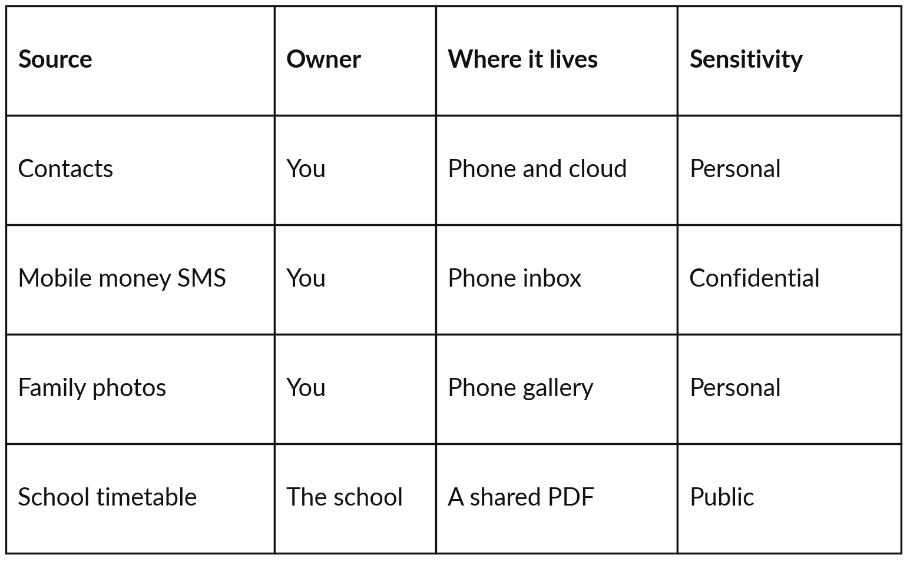
Your own phone already
holds a small data inventory
Three of the four sources are yours; the timetable belongs to the school.
Source: a place data is kept, such as a file or an app.
Sensitivity: the data classification of Session 13.
Notes:
Knowing the kinds is the start; the next step is to write them down, and your own phone is the easiest place to practise. A data source is any place data is kept: a file, an app, a folder. A data inventory is a written list of them, one row each.
Your contacts: you own them, they live on the phone and in the cloud, and they are personal data. Your mobile money text messages: confidential. Your family photos: personal. The school timetable: owned by the school, a shared PDF, public. Sensitivity is the data classification you used in Session 13, with Personal added when a living person can be identified. Nile Valley Foods keeps the same list, with one more column.

Slide 10
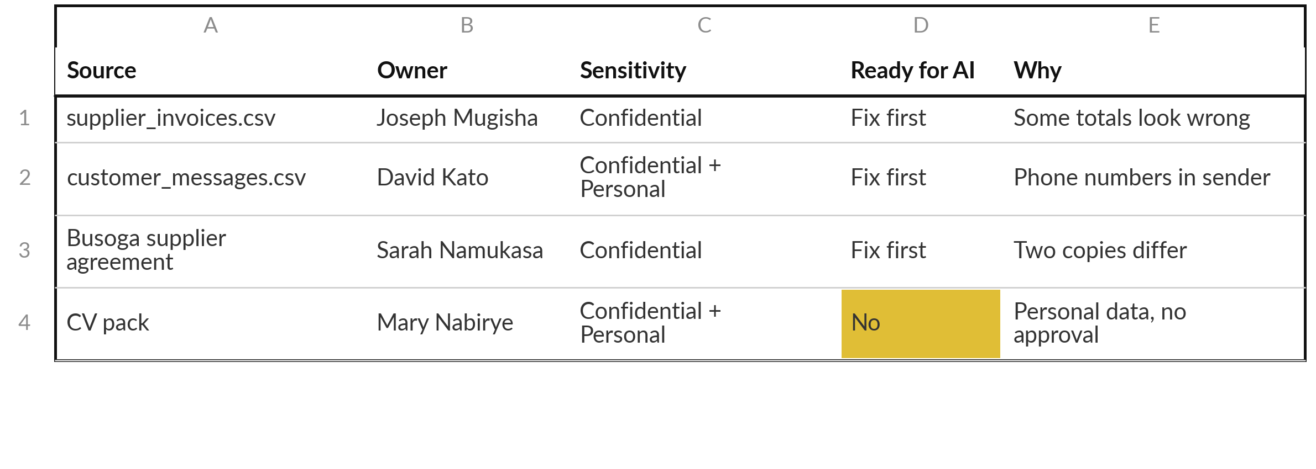
At NVF each data source gets an
owner, a classification and a verdict
Invented values for NVF. The file check later counts the faults.
Notes:
At NVF the list has the same columns, plus a verdict: is the source ready for AI?
The answer is Yes, Fix first or No. Here are four rows. The invoice file is confidential, and some totals look wrong. The customer messages hold phone numbers in the sender column, so they are personal as well as confidential. The supplier agreement has two copies that differ.
The CV pack is personal data with no approval for any AI tool, so the answer is no for now. This list is the first thing you build in the practice block. To say how wrong the invoice file is, we first need standard words for what can be wrong.

Slide 11
Six data quality dimensions, checked
in the pantry and then in the NVF files
Dimension | In the pantry | In the NVF files
Completeness | Every ingredient on the recipe is there | Some invoices have no purchase order (PO) number
Accuracy | The jar labelled sugar holds sugar | Some invoice totals are wrong
Consistency | Two jars of the same thing agree | Two copies of the Busoga agreement differ
Timeliness | Everything is in date | The data files carry no date
Uniqueness | One tin of each, no doubles | One invoice appears twice
Validity | Weights in grams, dates that exist | One invoice line has zero VAT
A PO number is the reference of the order an invoice belongs to. The file check later counts each fault.
Notes:
The standard words are six checks called data quality dimensions, first in the pantry. Completeness: is everything that should be there present?
Accuracy: is the value correct?
Consistency: do two records of the same thing agree?
Timeliness: is it current?
Uniqueness: is each thing recorded once?
Validity: does the value follow the allowed format or rule, such as a date that exists?
The right column shows a fault of each kind in the NVF files. A PO number is the purchase order reference, so an invoice without one cannot be matched to its order. The exact label matters less than naming the fault. Two of these dimensions can be measured with one fraction each, and a tiny list is enough to learn both.

Slide 12
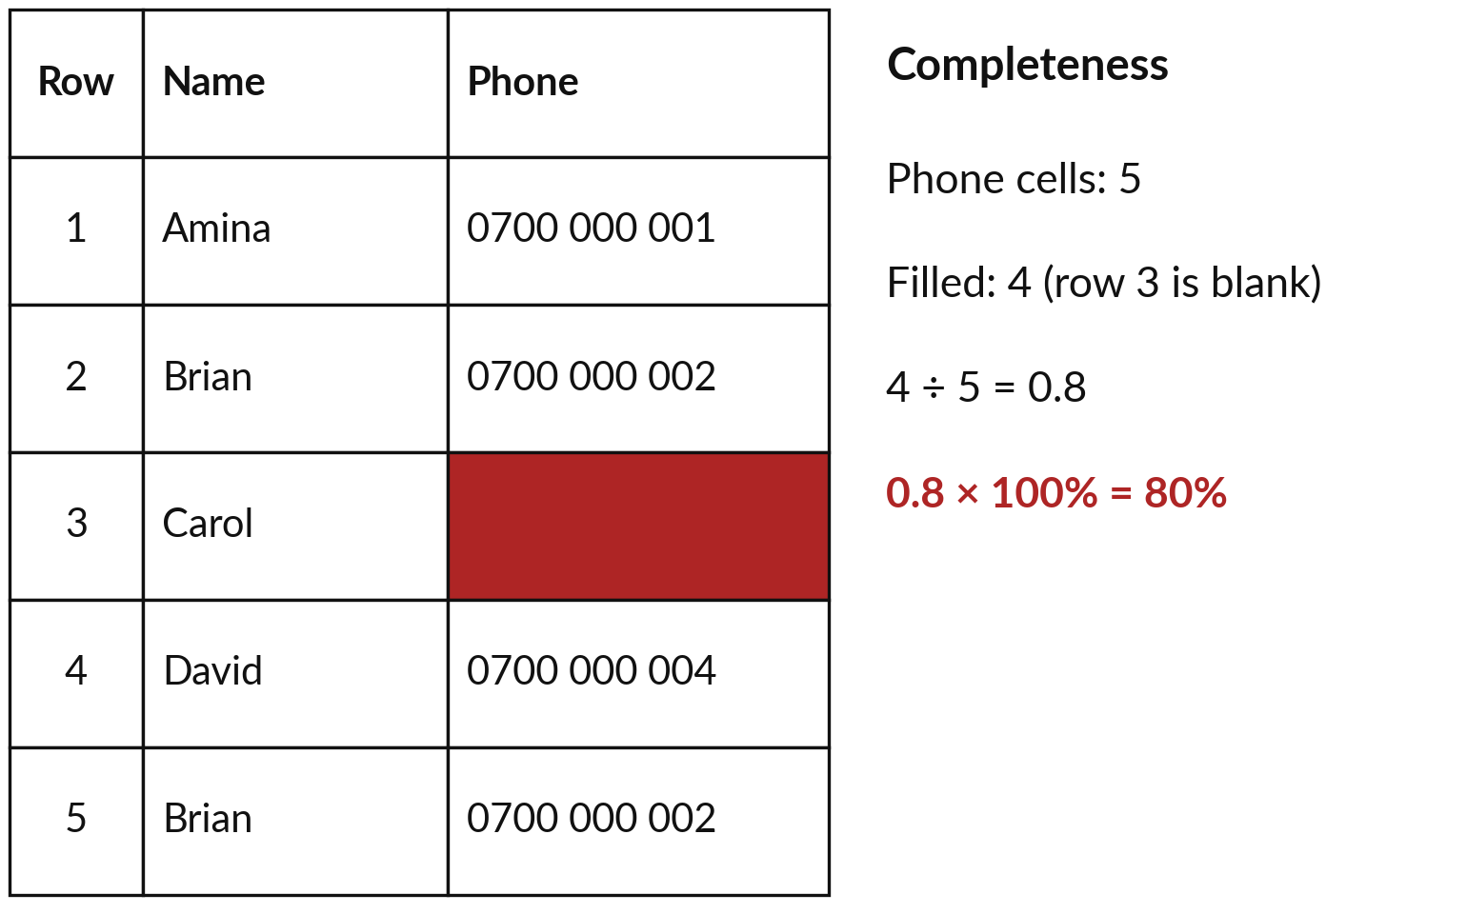
Completeness, worked by hand: 4 of
5 phone numbers are filled, so 80%
Completeness: the share of cells that should hold a value and do.
Completeness = filled values ÷ all values × 100%.
100% means nothing is missing.
Notes:
Take an invented contact list of five rows, the kind you keep for a club or a family group. Completeness asks: of the cells that should hold a value, how many do?
Look at the phone column. There are five cells. Four are filled; Carol’s, in row three, is blank. Four out of five is four divided by five, 0.8. A share like this is a part divided by the whole. Times one hundred percent, it is 80 percent. That is the whole formula: completeness equals filled values divided by all values, times one hundred percent.
One hundred percent means nothing is missing, and lower is worse. But look again at the names: one person appears twice.

Slide 13
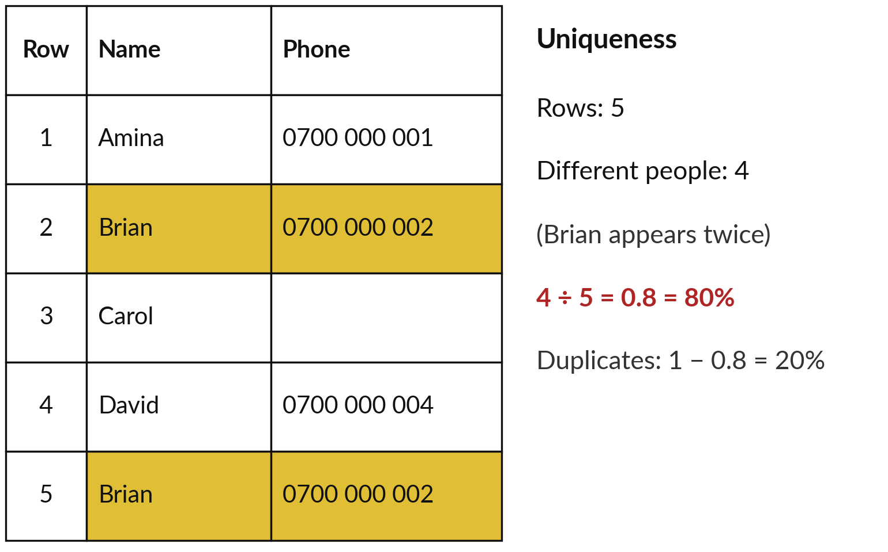
The same list has 4 different people
in 5 rows, so uniqueness is 80%
Uniqueness: the share of records that are not repeats.
Uniqueness = distinct records ÷ all records.
A duplicate invoice can be paid twice.
Notes:
Brian is in row two and again in row five, with the same phone. That is a duplicate, the same thing recorded twice, and uniqueness measures it. Count the rows: five. Count the different people, each counted once: Amina, Brian, Carol and David, four. The standard word for counted once is distinct.
Four divided by five is 0.8, or 80 percent. So uniqueness equals distinct records divided by all records. One minus 0.8 is 0.2, a duplicate rate of 20 percent: one row in five is a repeat. A duplicate contact is a nuisance; a duplicate invoice can be paid twice, which is why the NVF files get counted next.

Slide 14
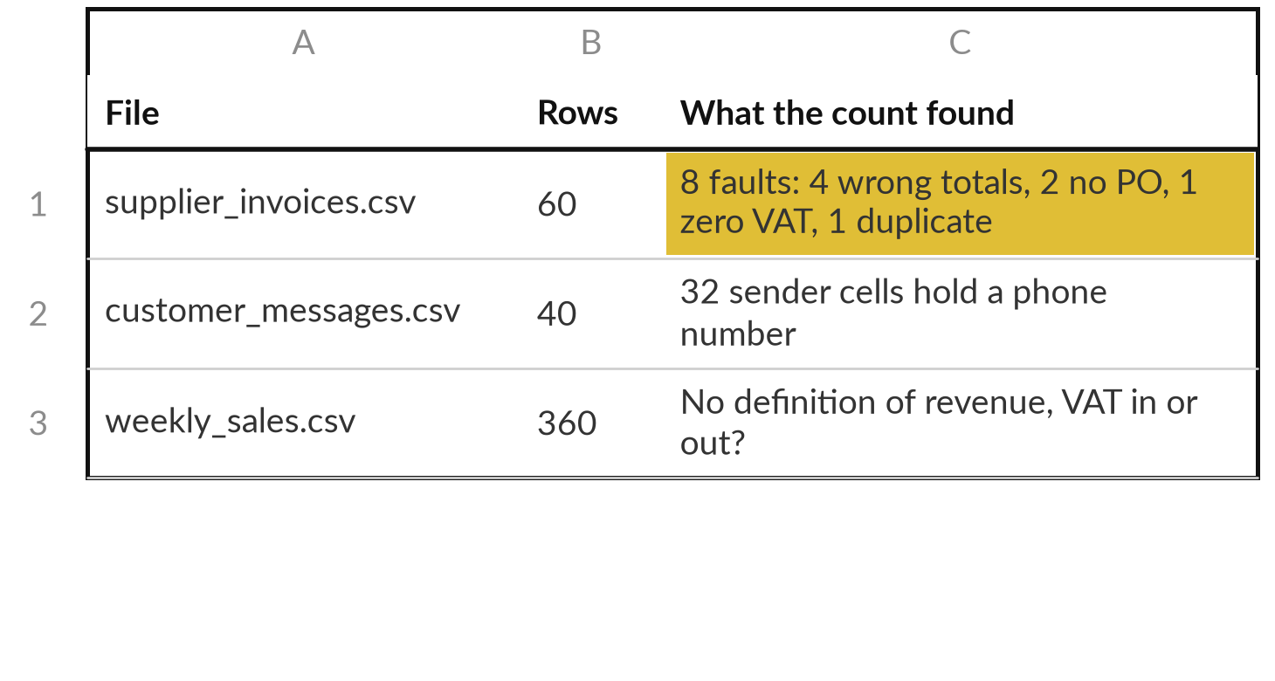
Demonstration: a script counts the
data quality faults in the NVF files
I will show
Watch for
A short script gives exact counts.
Personal data hides in ordinary columns.
A file can be readable and still unclear.
Notes:
Now the real files. This is a recorded run on 6 November 2026, with a short Python script. No AI model is used; the script only counts. Watch for the faults and the phone numbers. The invoice file has sixty rows and eight faults: four wrong totals (accuracy), two missing purchase order numbers (completeness), one line with zero VAT (validity) and one duplicate (uniqueness).
The customer messages file has forty rows, and thirty two sender cells hold a phone number, which is personal data. The sales file has three hundred and sixty rows and no definition of revenue: with VAT or without? The script is in the demonstration folder, so you can run it on your own files.

Slide 15
The NVF invoice file is 96.7%
complete and 98.3% unique
Dimension | Formula | NVF invoice file (60 rows)
Completeness | filled values ÷ all values × 100% | PO numbers: (60 − 2) ÷ 60 × 100% = 96.7%
Uniqueness | distinct records ÷ all records | Invoice IDs: 59 ÷ 60 = 0.983, or 98.3%
Filled: a cell with a value. Distinct: counted once. Duplicate rate = 1 − uniqueness = 1.7%.
Notes:
The two fractions from the contact list work the same on the invoice file. Completeness of the PO number column: sixty cells, two blank, so fifty eight filled. Fifty eight divided by sixty is 0.967, times one hundred, 96.7 percent. Uniqueness of the invoice numbers: two rows share one number, so sixty rows hold fifty nine distinct invoices.
Fifty nine divided by sixty is 0.983, or 98.3 percent, and the duplicate rate is one minus that, about 1.7 percent. These look high, and one duplicate can still mean paying a supplier twice. Data teams track these numbers over time. Percentages measure one column; to judge a whole organisation we need a broader tool.

Slide 16
Score six areas Green, Amber
or Red by a rule you can apply
Area | Green when | Red when
Inventory | A written list with owners | No list; files on personal phones
Readable | Text can be selected and copied | Paper, photos, faint scans
Complete and unique | One current copy, no gaps | Copies disagree; rows missing
Metadata | Date, owner and version on each file | Names such as “final2”
Rights | Who may use it is written down | Unknown; personal data unchecked
Current | Updated on a set schedule | Nobody knows the latest version
Amber: usable after a named fix. Points: Green 2, Amber 1, Red 0. Six areas × 2 points = 12 at most.
Notes:
That broader tool is the readiness scorecard you first met in Session 0, here from the Information Inventory template. It rates six areas Green, Amber or Red by a written rule. Inventory: is there a written list with owners?
Readable: can the text be selected and copied?
Complete and unique: one current copy, no gaps, the two fractions we just worked. Metadata: date, owner and version on each file. Rights: is it written down who may use the data?
Current: updated on a schedule?
Green when the rule is met, Red when the right column describes you, and Amber when it is usable after a named fix. To add colours up, we turn them into points: Green two, Amber one, Red zero. Six areas times two gives at most twelve. Where will your first Red be?

Slide 17
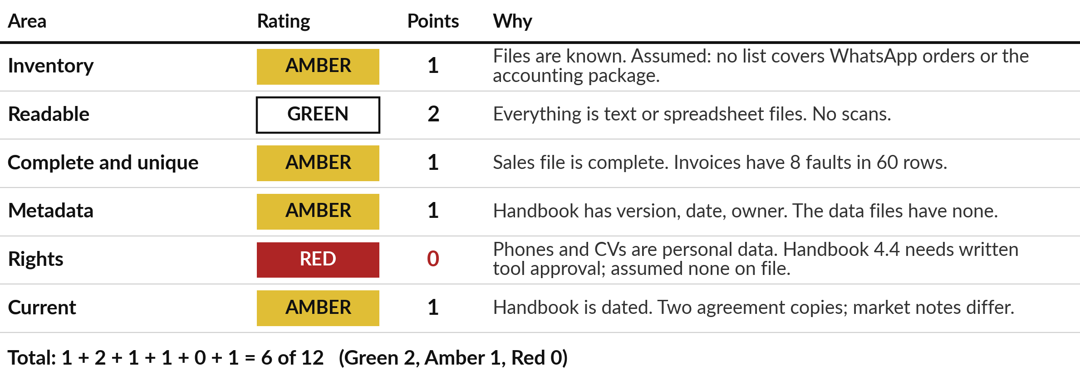
Nile Valley Foods scores 6 of
12, with one Red on rights
Readiness score = Σ points. Σ (sigma) means add up, one term for each of the six areas.
Notes:
Read the Nile Valley Foods scorecard from the top. Inventory is Amber, one point: no list covers WhatsApp orders. Readable is Green, two points, because everything is text or spreadsheet files. Complete and unique, and Metadata, are Amber, one point each. Rights is Red, nought, because phone numbers and CVs are personal data and we assume no tool has written approval on file. Current is Amber, one.
Add the Points column from the top: one plus two plus one plus one plus nought plus one is six of twelve. In symbols, the readiness score is sigma of the points. Sigma means add up, one term for each area. Every rating has one line of evidence; without it a rating is only an opinion. And a Red on rights stops the project until a lawyer has looked, whatever the total. Fixing the weak areas takes six steps.

Slide 18
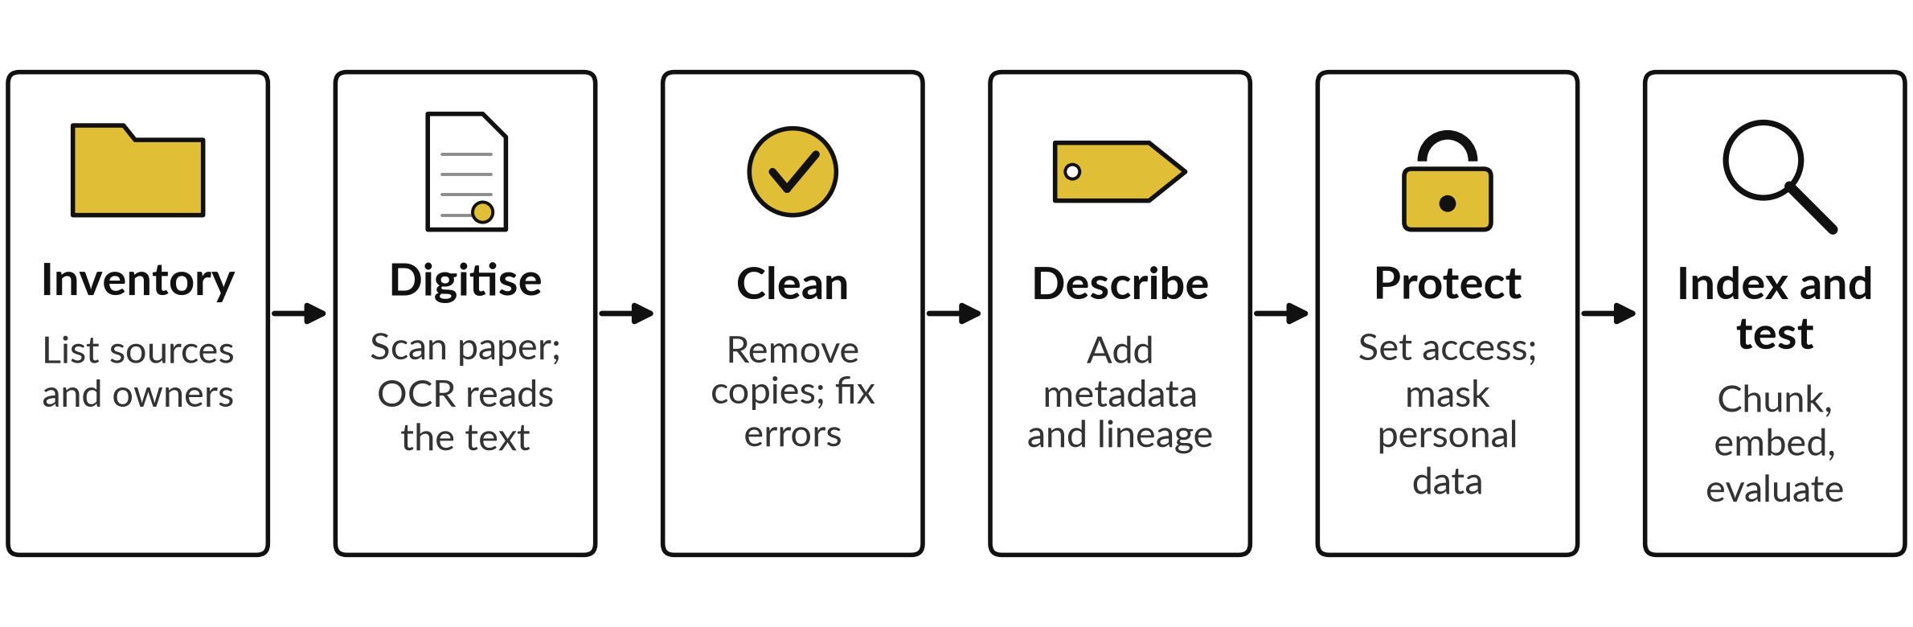
Six steps turn scattered files into AI-ready data
Start with one folder and one task. Test it, then widen.
Notes:
The scorecard shows what is weak; the six steps you first saw in Session 0 fix it, in order. One, inventory: list every source, its owner and its format. Two, digitise: scan paper and read the text with optical character recognition. Three, clean: remove duplicates and fix errors, which raises completeness and uniqueness. Four, describe: add metadata, meaning date, owner and version, and note the lineage, where each file came from.
Five, protect: set who can see what and mask personal data. Six, index and test: chunk the text into passages, turn them into embeddings as in Session 4, and evaluate with real questions with known answers. Skipping the last step is the usual mistake. Start with one folder and one task.

Slide 19
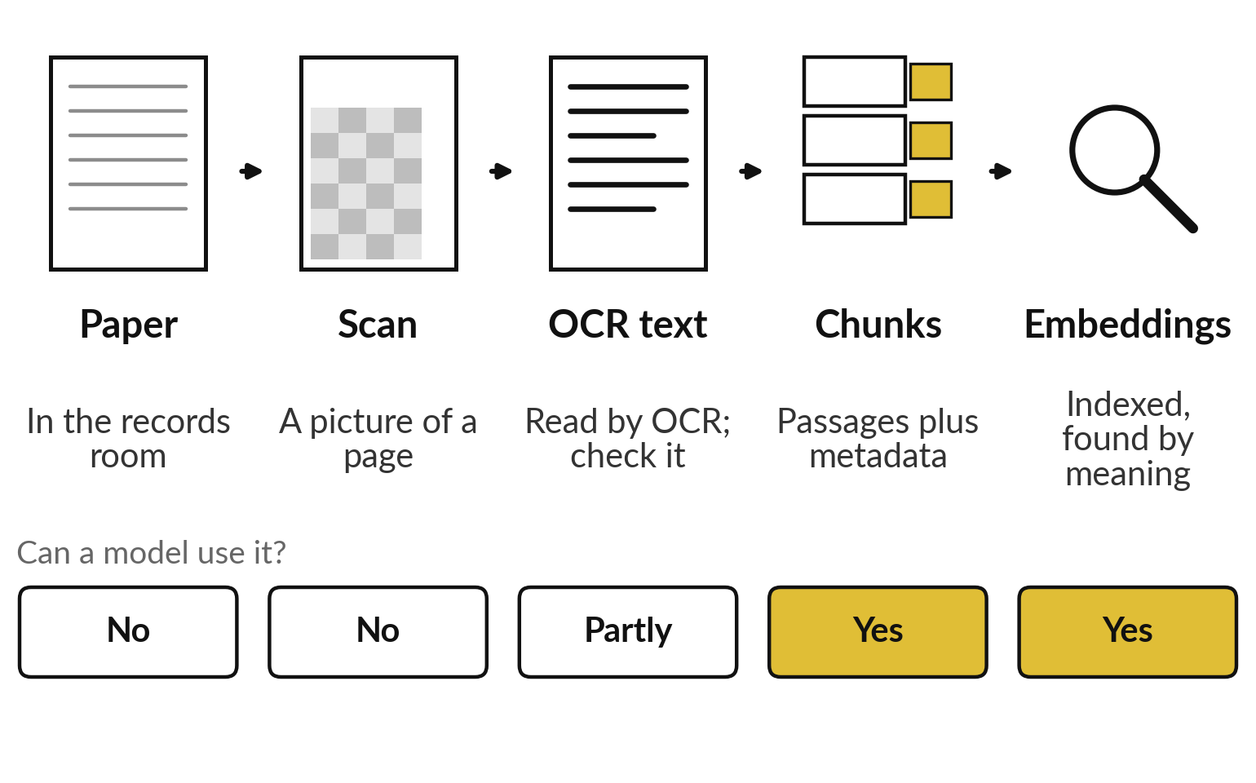
A scan is a picture until OCR reads it, and chunking,
metadata and embeddings make it findable
Each stage adds what a model can use.
OCR: software that reads text from an image.
Chunking: splitting text into passages to retrieve.
Embedding: a vector (list of numbers) for meaning.
Notes:
Steps two to six sound abstract, so follow one page of a printed recipe book through them. On paper, a model can do nothing with it. A scan is an image, a grid of numbers as in Session 1, still no words. After optical character recognition there is text, though with errors, so you check a sample.
Chunking is like cutting the book into one recipe per card, each card labelled with metadata such as date and owner, which is what the retrieval of Session 9 needs. Turned into embeddings and indexed, as in Session 4, the cards can be found by meaning. Start with search, and test it before anyone relies on it.

Slide 20
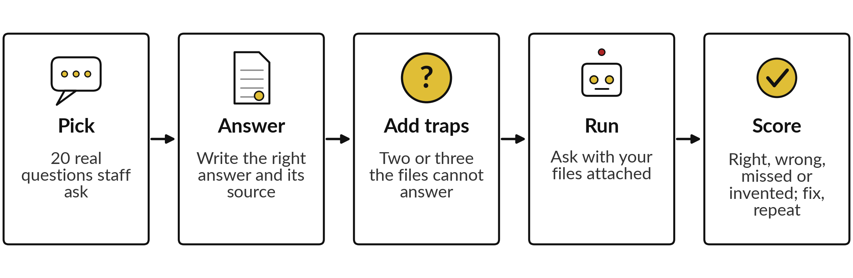
An evaluation set of twenty questions
with known answers is the first test
Write the line for success first. About 50 questions give a firmer result.
Notes:
You built one of these in Session 10: an evaluation set, questions with known answers, like a quiz with its answer key, used to measure how well a system performs. There it had ten questions and scored a tool; here it tests your own data. Pick twenty real questions that staff ask. Write the correct answer and the source file for each. Add two or three traps that the files cannot answer, because the right reply is that the files do not say.
Run the questions with your files attached. Label each answer right, wrong, missed or invented, as in Session 10, and fix the gaps. Write the line for success before you run it, for example sixteen of twenty right and none invented. Fifty questions give a firmer result.

Slide 21
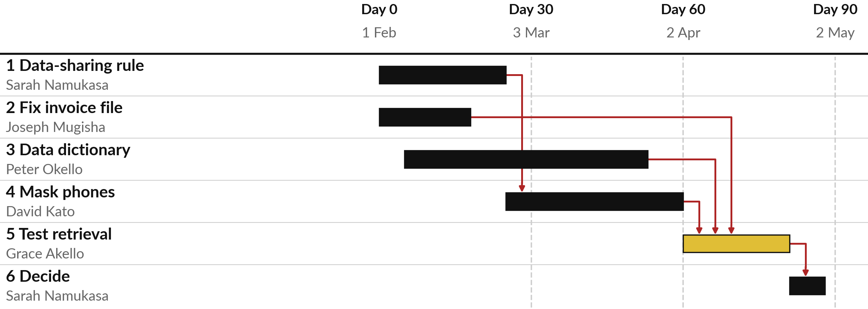
A roadmap puts rights and
cleaning before the test
NVF plan, 1 February 2027. Red arrows show what waits.
Notes:
Planning a trip, you book the visa before the ticket. A roadmap puts actions in that order. This is the data roadmap for Nile Valley Foods, from the 90-Day Roadmap template, starting on the first of February. The points at day thirty, sixty and ninety are milestones, dated checkpoints.
The gold bar is the retrieval test. It waits for the invoice file fixed, the data dictionary written and the phone numbers masked. Masking waits for the data sharing rule, because rights is the Red area. The red arrows show these dependencies. If you test before you fix rights, you test something you may not be allowed to use.
Each bar has one named owner. Who would own the first bar in your roadmap?

Slide 22
Every roadmap line has an
owner, a date, hours and a KPI
Action | Owner | Due | Hours | Depends on | Success measure
1 Write the data-sharing rule | Sarah Namukasa | 26 Feb | 4 | None | Rule signed and filed
2 Fix the invoice file | Joseph Mugisha | 19 Feb | 6 | None | 0 faults on recheck
3 Write the data dictionary | Peter Okello | 26 Mar | 8 | None | Every column defined
4 Mask phones in the export | David Kato | 2 Apr | 5 | 1 | 0 phones in the copy
5 Test retrieval | Grace Akello | 23 Apr | 10 | 2, 3, 4 | 16 of 20 right, none invented
6 Decide | Sarah Namukasa | 30 Apr | 2 | 5 | Decision recorded
Six Roadmap sheet columns. Total effort = Σ hours = 4+6+8+5+10+2 = 35. A KPI (key performance indicator) is a number someone else can check.
Notes:
Behind each bar in that picture sits a line of the roadmap. These are the six lines, using the real columns of the Roadmap sheet: action, owner, due date, effort in hours, depends on, and success measure. A success measure is a key performance indicator, a KPI: a number that someone else can check. Better data quality is a wish. Zero faults on recheck by the nineteenth of February is a measure.
Sixteen of twenty test questions right, with none invented, is a measure. The hours are estimates, and the total effort is the sum of the hours, four plus six plus eight plus five plus ten plus two, which is thirty five hours across five people. Which of your own actions needs a measure like these?

Slide 23
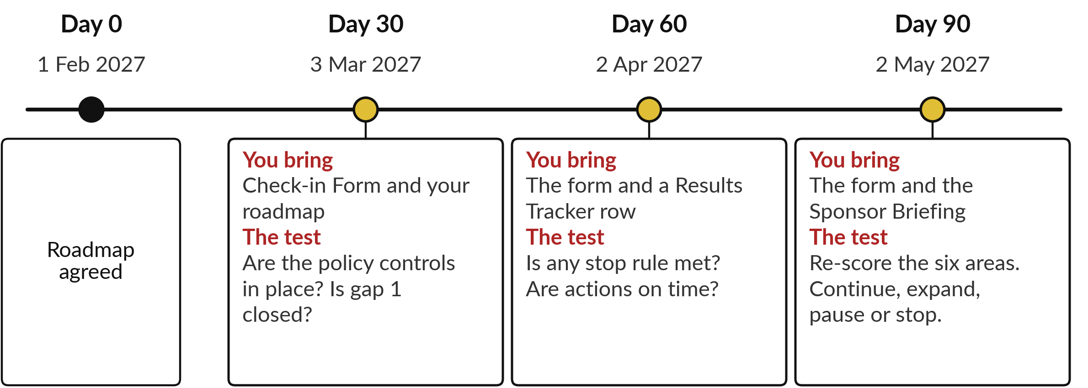
Check-ins at day 30, 60 and
90 keep the plan honest
Notes:
A roadmap nobody reviews drifts, so the plan needs three milestones, like a school term with reports at set points. These are the check-ins. After this session your plan runs for ninety days from the start date you choose. The dates on the slide are for NVF, starting on the first of February. At day thirty you bring the Check-in Form and your roadmap, and the test is whether your policy controls are in place and your first gap is closed.
At day sixty you add a row from the Results Tracker, and the test is whether any stop rule is met and whether actions are on time. At day ninety you bring the Sponsor Briefing and re-score the six areas. Then you decide: continue, expand, pause or stop. Your lecturer messages you before each date. That day ninety re-score needs one more formula.

Slide 24
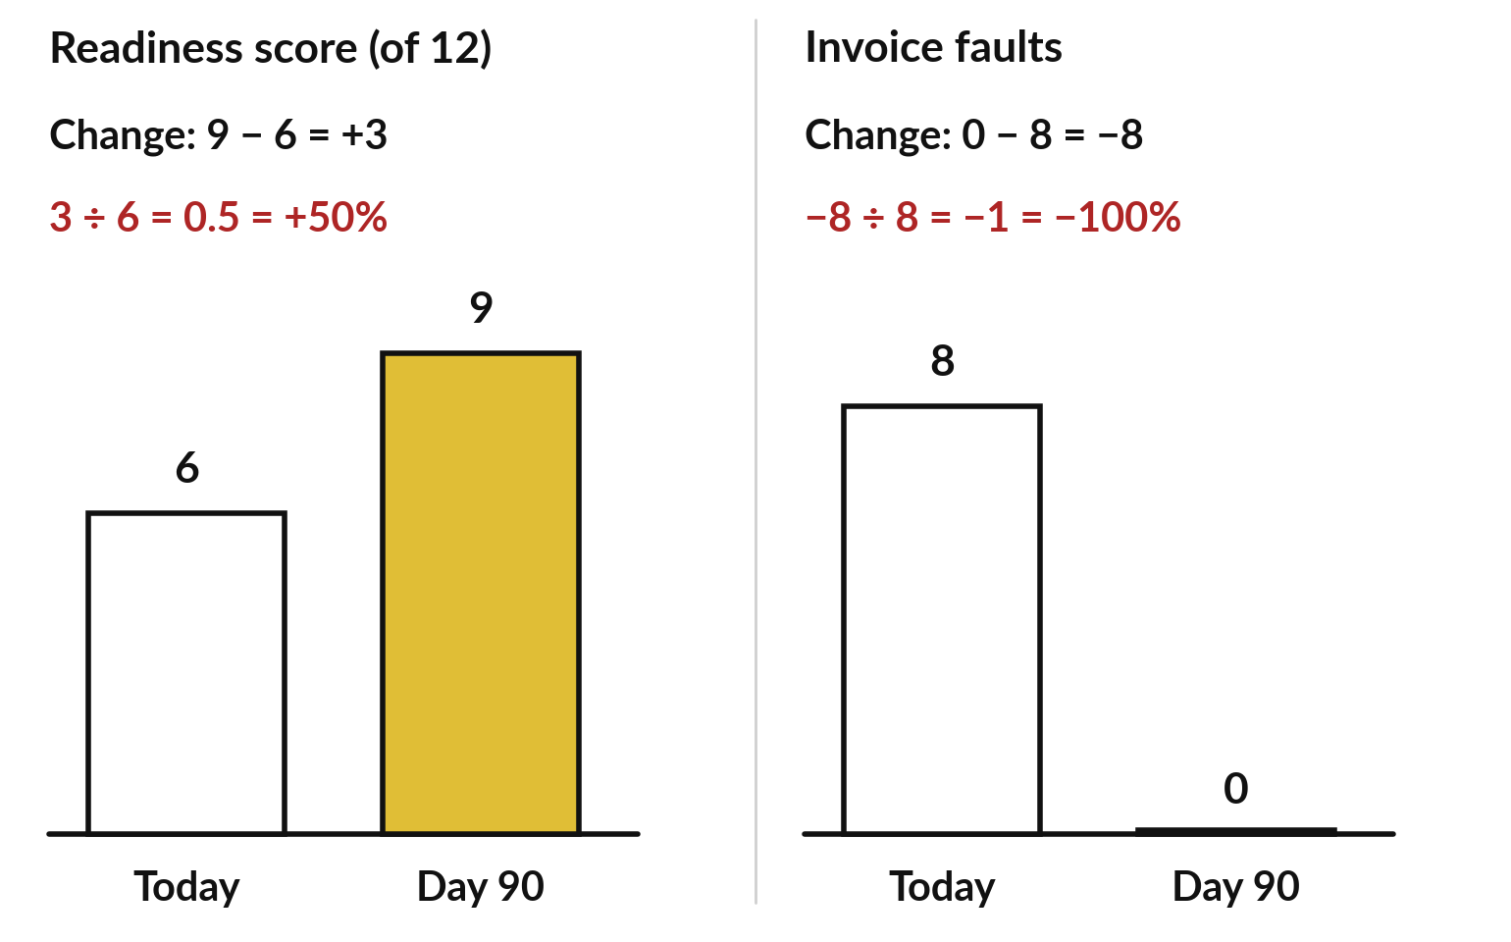
On day 90 you re-score and
report the change as a KPI
KPI change = (new − old) ÷ old × 100%.
+3 from 6 is large; +3 from 60 is small.
Set your day 90 target now, while you plan.
Notes:
At the day ninety check-in the plan ends where it started: with the same scorecard, scored again by the same rules. For NVF, six of twelve today and nine at day ninety, a teaching value. The change is nine minus six, plus three. But plus three means more when you start at six than at sixty, so we compare it with the start: three divided by six is 0.5, plus fifty percent. Invoice faults go from eight to none: nought minus eight is minus eight, and minus eight divided by eight is minus one, minus one hundred percent, all faults gone. In words, KPI change equals new minus old, divided by old, times one hundred percent.
So when you plan, write the target as well as the action. After the break you build your own, starting with your sources.

Slide 25
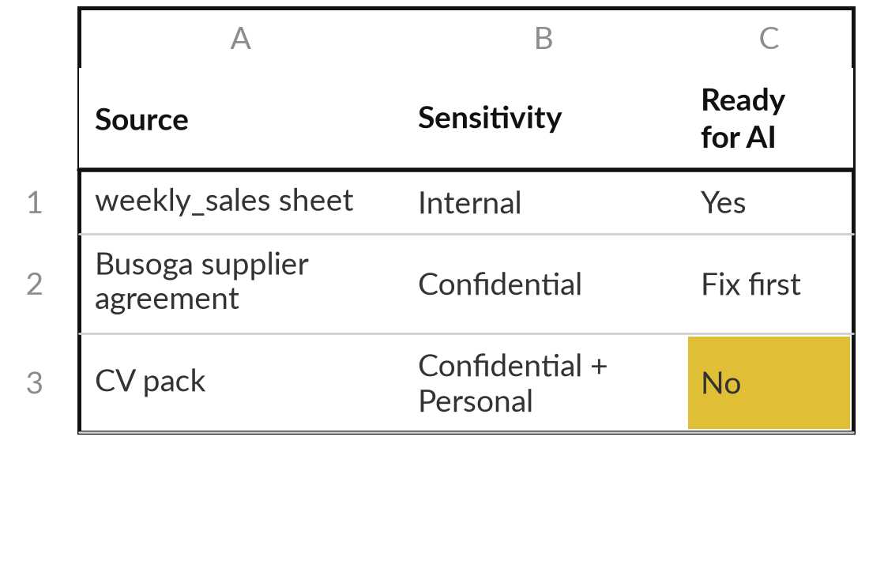
List your sources and label each by sensitivity
15 minutes
Hands-on, on your own organisation
Build your Information Inventory.
Open Information Inventory.xlsx, sheet Inventory. Start from row 7.
One source per row: Source, Owner, Format, Where it lives, Who may see it.
Mark Sensitivity (data classification): Public, Internal or Confidential, plus Personal for a living person.
Mark Ready for AI: Yes, Fix first or No, and What to fix first.
You keep: An inventory of at least six sources, each labelled and owned.
Notes:
Welcome back. You have seen the whole method on NVF, so now you build yours, starting with your sources. You have fifteen minutes, and I walk round while you work. Open the Information Inventory and use the Inventory sheet from row seven. The three grey rows show NVF examples. List every source your organisation holds that an AI tool might touch, one per row. Write the owner, the format, where it lives and who may see it. Then label it public, internal or confidential, and add personal when it identifies a living person.
Finally mark whether it is ready for AI: yes, fix first, or no. Include the awkward sources, such as WhatsApp orders and files on personal phones. Aim for at least six rows.

Slide 26
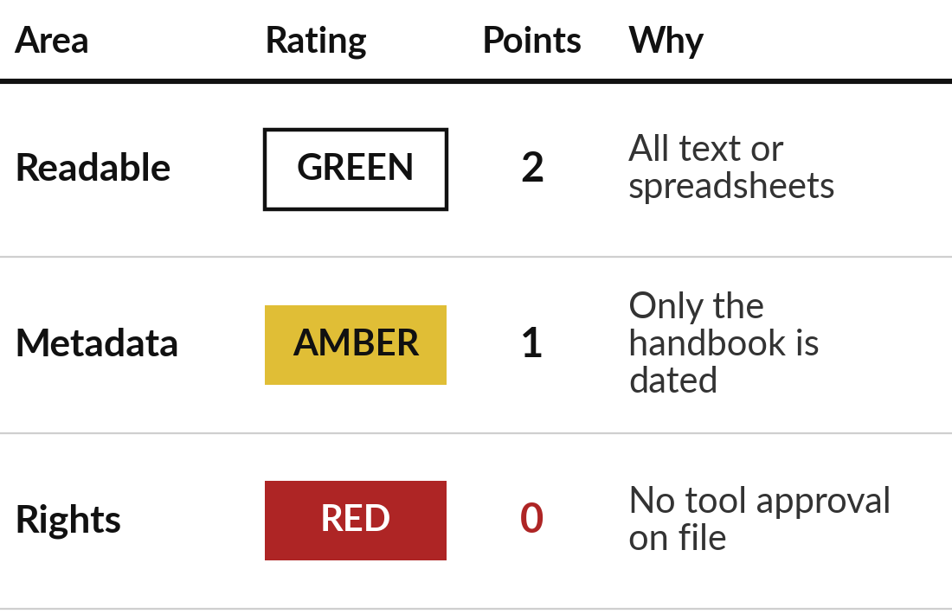
Score the six areas for your own organisation
15 minutes
Hands-on, on your own organisation
Complete the Readiness scorecard sheet.
Look at your inventory rows for each of the six areas.
Choose My rating: Green, Amber or Red, using the rule.
Write My reason (evidence) for each rating.
Read your total out of 12. Pick your top three gaps.
You keep: Six ratings with evidence, a total out of 12 and three gaps.
Notes:
With your sources listed, you can now score them. Another fifteen minutes, and I keep walking round. Stay in the same workbook and move to the Readiness scorecard sheet. For each of the six areas, look at your inventory rows and choose Green, Amber or Red using the rule on the slide before. Write one line of evidence for each rating. The sheet adds the points and shows your total out of twelve.
Then pick your top three gaps, the Red or Amber areas that block your work most, and for each write the evidence, a first fix and a possible owner. Tell me your total and your first Red.

Slide 27
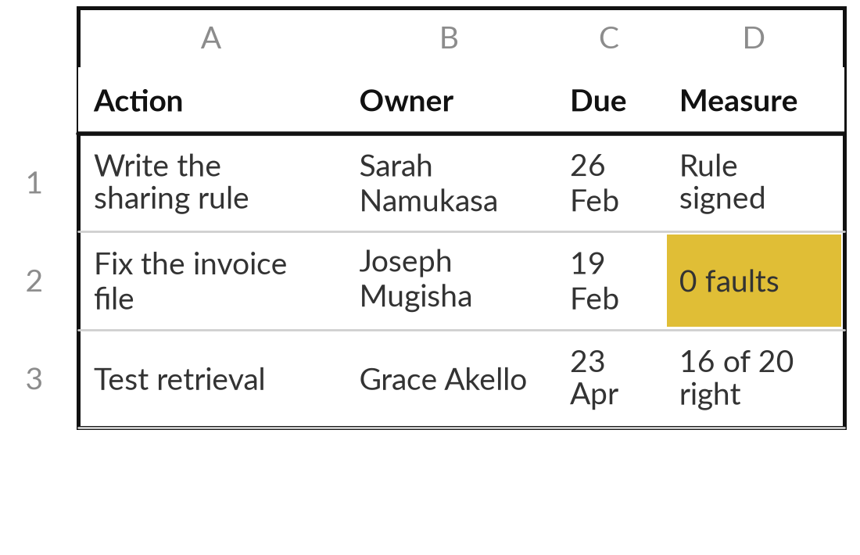
Turn your gaps into a roadmap
15 minutes
Hands-on, on your own organisation
Fill the Roadmap sheet of 90-Day Roadmap.xlsx.
Write your plan start date. The check-in dates follow from it.
One action for each gap: Phase, Action, Owner, Start, Due, Effort (hours).
Fill Depends on. Rights and cleaning come before any test.
Rewrite each Success measure as a KPI: a number someone else can check.
You keep: A roadmap of at least six actions with owners, dates, hours and measures.
Notes:
Your gaps are the raw material of the roadmap, so each one now becomes an action. You have fifteen minutes, and I walk round. Open the 90-Day Roadmap, sheet Roadmap. First write your plan start date, and the check-in dates follow. Then write one action for each of your gaps. Each line needs a phase, an action a person can finish, one owner, a start, a due date and the effort in hours.
The three phases are protect and clean, describe and prepare, and test and decide. Fill Depends on so that rights and cleaning come before any test. Then rewrite each success measure as a number someone else can check. Aim for six actions. Finish the rest after class.

Slide 28
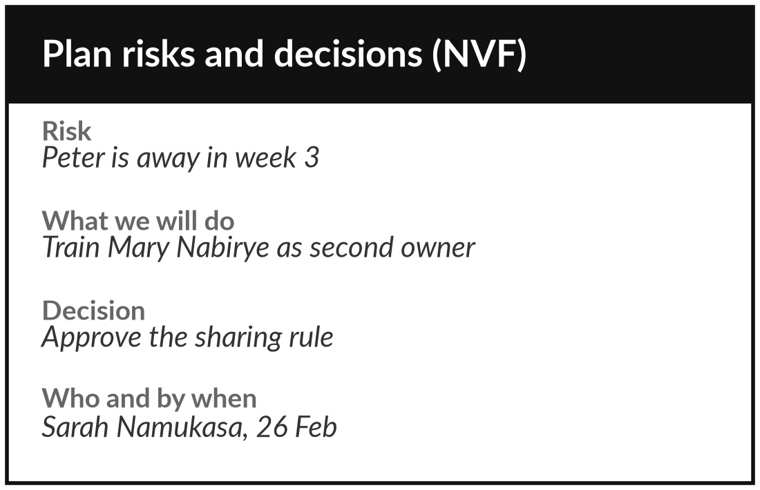
Set your check-ins, risks and decisions
10 minutes
Hands-on, on your own organisation
Fill the Decisions, Risks and Check-ins sheets.
Check-ins: read your day 30, 60 and 90 dates and put them in your diary.
Decisions: write each decision the company must make, who decides and by when.
Risks: list three risks to the plan, one about people being away.
Name who you will tell first about your plan.
You keep: Three dated check-ins, a decisions list and three risks to the plan.
Notes:
A roadmap also needs its checks, its risks and its decisions. You have ten minutes for this last practice block, and I walk round. Three more sheets in the same workbook. On Check-ins, read the three dates that follow from your start date and put them in your diary now. On Decisions, write each decision your organisation must make during the ninety days, who decides, and by when. For NVF one is approving the data sharing rule.
On Risks, list three risks to the plan itself, including at least one about people being away, such as the owner of a key action. Write what you will do about each. Finally name the person you will tell first about this plan.

Slide 29



How much will you take on in the next 90 days?
How many gaps will your roadmap close by day 90?
One gap, finished
Three gaps, started
Prove retrieval first
Fix your first gap fully and test it. A real result at day 90. Recommended for most.
Move all three a little. More progress to show, less certainty at day 90.
Test one folder now. Only if rights are not Red.
Say your choice aloud and write it at the top of your roadmap.
Notes:
Your roadmap now exists, and the question is how much of it to start. One decision before we look back. How much will you take on in the next ninety days?
One gap, finished, gives you a real measured result at day ninety, and it is what I recommend for most. Three gaps, started, gives more to talk about and less certainty. Prove retrieval first suits you only if rights is not Red, because testing data you may not use is the wrong order.
Look at the roadmap you just wrote. Say your choice aloud, and write it at the top of your roadmap with your day ninety target, using the KPI change from earlier. Then name one action you will take in the next twenty four hours.

Slide 30
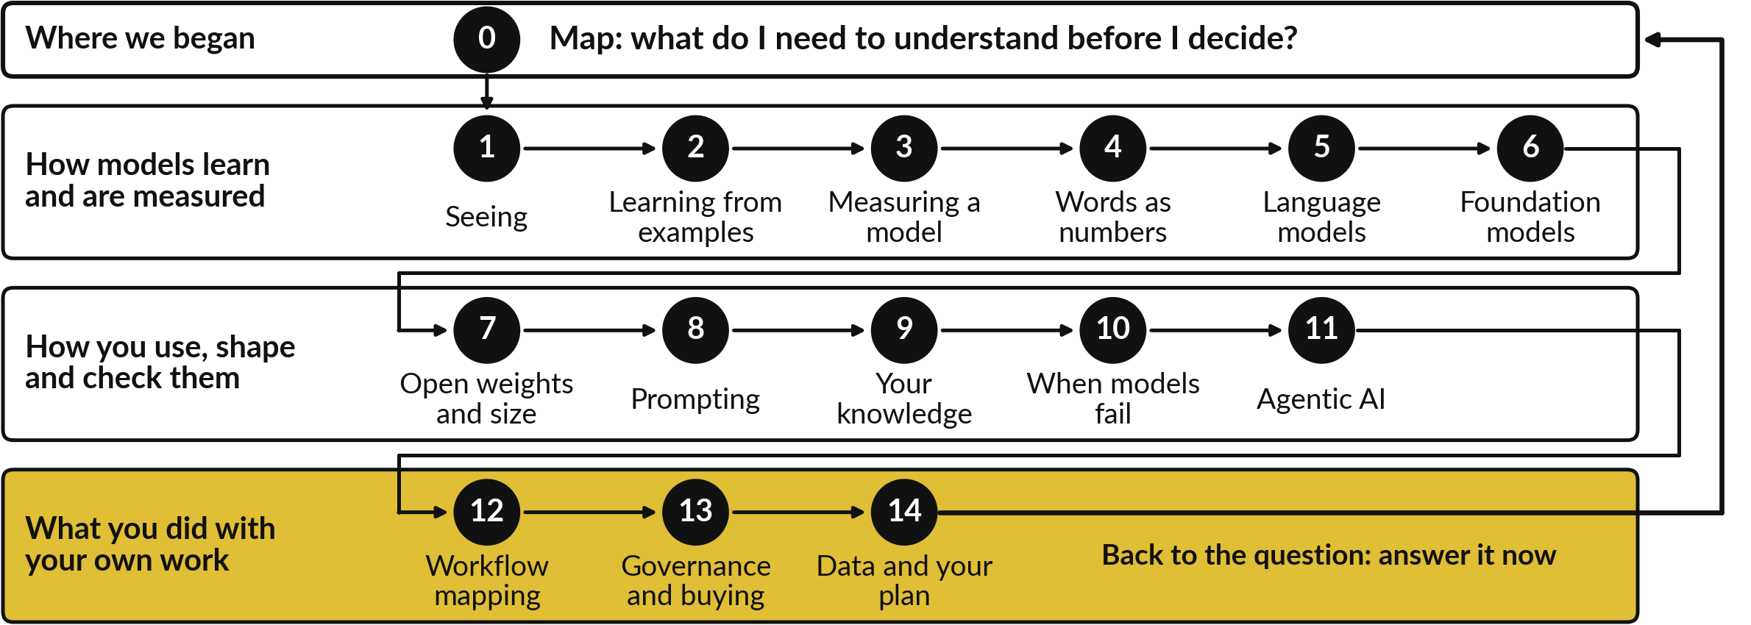
Fourteen sessions form one chain, from
the map question to your 90-day plan
One chain: each session builds on the last, and Session 14 leads back to the Session 0 question.
Notes:
With your choice written, step back from today and look at all fourteen sessions on one page, read as one chain. It starts at Session 0, the map, with one question: what do I need to understand before I decide? The top row is how models work, from pixels and neurons to foundation models. Session 6 leads into Session 7, and the middle row is how you use, shape and check them, from open weights to agents.
Session 11 leads into Session 12, and the bottom row is what you did with your own organisation: a workflow map, rules and vendor questions, and a data plan. The last arrow runs from Session 14 back to the question. Pick one station that changed how you think. Then answer that question in two sentences: what do you now understand about AI before you decide anything about it?

Slide 31
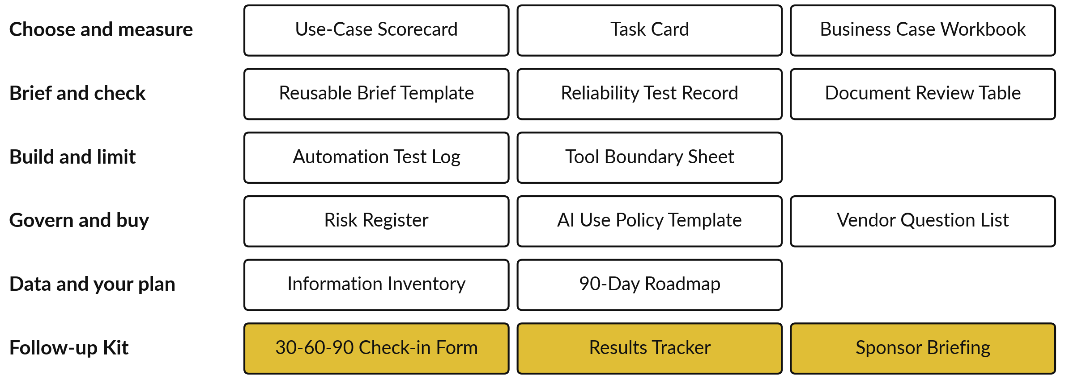
Your working papers and the
follow-up kit go home with you
Notes:
That chain is the thinking, and these are the papers you carry out of the room. This is everything you now hold. Working papers for choosing and measuring a task, for briefing and checking a model, for building and limiting an automation, for governing and buying, and for your data and your plan. In gold is the follow-up kit: the Check-in Form, the Results Tracker and the Sponsor Briefing.
Papers do nothing alone. The plan works when each action has a named owner and each date is in a diary. In the next twenty four hours, book the dates and tell each owner their action.

Slide 32
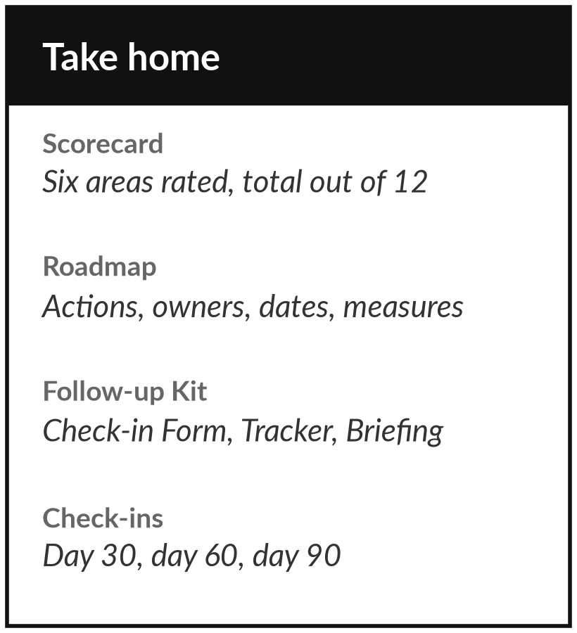
You finish with a plan, owners and three dates
What you keep from today
Your inventory and scorecard, your roadmap with its risks and decisions, the Follow-up Kit (Check-in Form, Results Tracker, Sponsor Briefing) and your answer to the Session 0 question.
Our question today
How ready is my organisation’s data for AI, what will I fix first, and who will own it?
After the course
Your check-ins fall 30, 60 and 90 days after your start date. Your lecturer messages you before each one. Bring the Check-in Form and your roadmap.
Notes:
Take everything home. Your check-ins fall thirty, sixty and ninety days after the start date you wrote on your roadmap. Your lecturer messages you before each one. At day thirty bring the Check-in Form and the roadmap. At day sixty add a row from the Results Tracker. At day ninety bring the Sponsor Briefing and re-score the six areas. Within twenty four hours, book the dates and tell each owner their action.
Look back for a moment. The last arrow on the course picture ran from Session 14 back to Session 0 and its question: what do I need to understand before I decide? You have since followed one chain from pixels to a plan for your own data, and your two-sentence answer is part of what you keep. Now we close the loop on today’s question.
We began with this question: How ready is my organisation’s data for AI, what will I fix first, and who will own it? Before you go, say in one sentence what you can now say about it.

